Slide 1


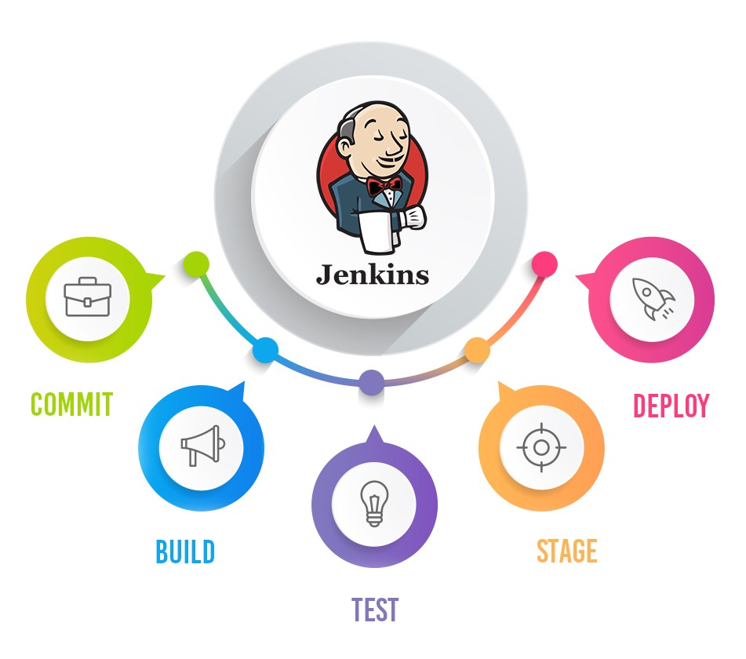
Jenkins Mastery for Software Tester
Pramod Dutta
How to Enable/ Disable Login in Jenkins

Slide 2

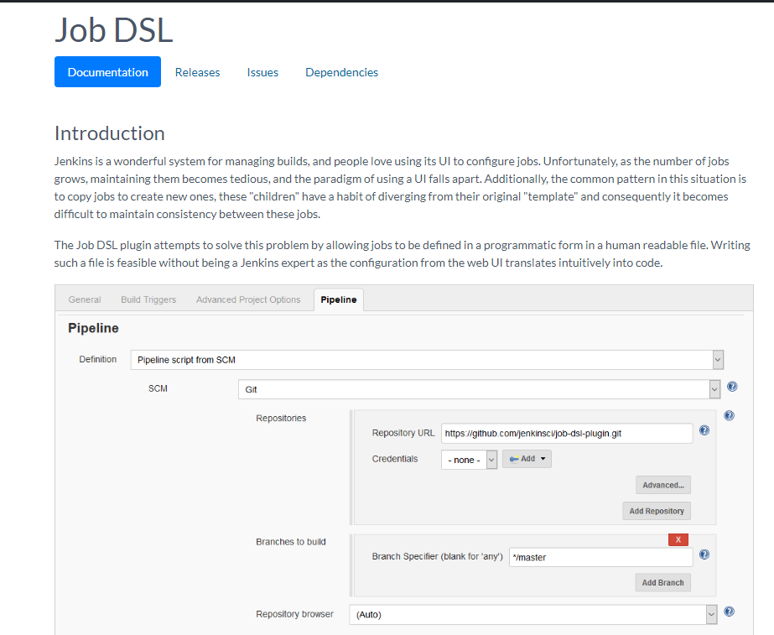
What is Jenkins DSL?
Generate the Jenkins Jobs using the Program or Code.
We will use Groovy to create Job.
https://plugins.jenkins.io/job-dsl/

Slide 3
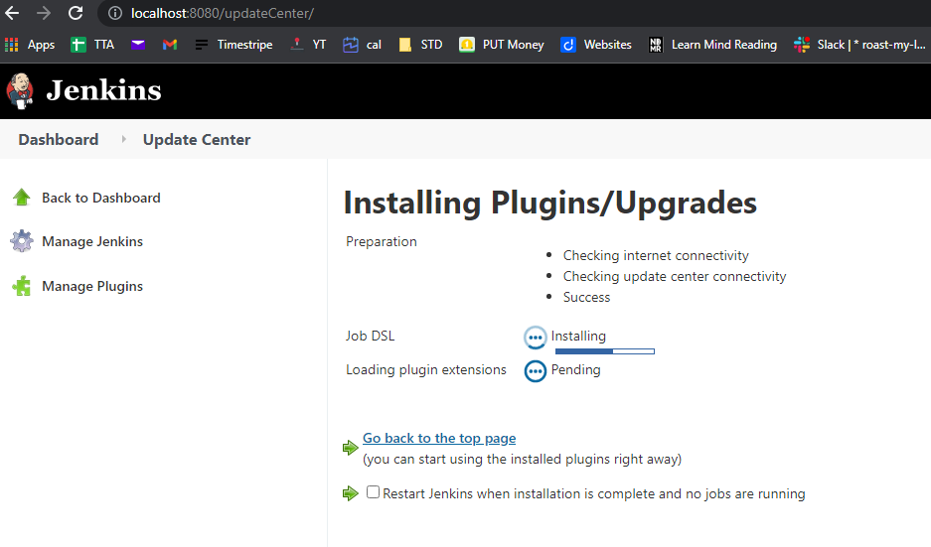
Install Plugin of Jenkins DSL?

Slide 4
Example of Jenkins JOB DSL
https://jenkinsci.github.io/job-dsl-plugin/#path/freeStyleJob-steps-maven
job('example') {
steps {
maven('verify')
maven('clean verify', 'module-a/pom.xml')
maven {
goals('clean')
goals('verify')
mavenOpts('-Xms256m')
mavenOpts('-Xmx512m')
localRepository(LocalRepositoryLocation.LOCAL_TO_WORKSPACE)
properties(skipTests: true)
mavenInstallation('Maven 3.1.1')
providedSettings('central-mirror')
}
}
}

